Slide 1
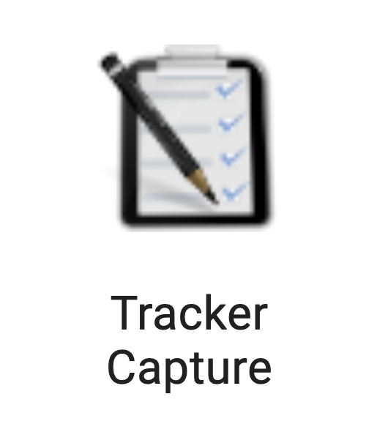
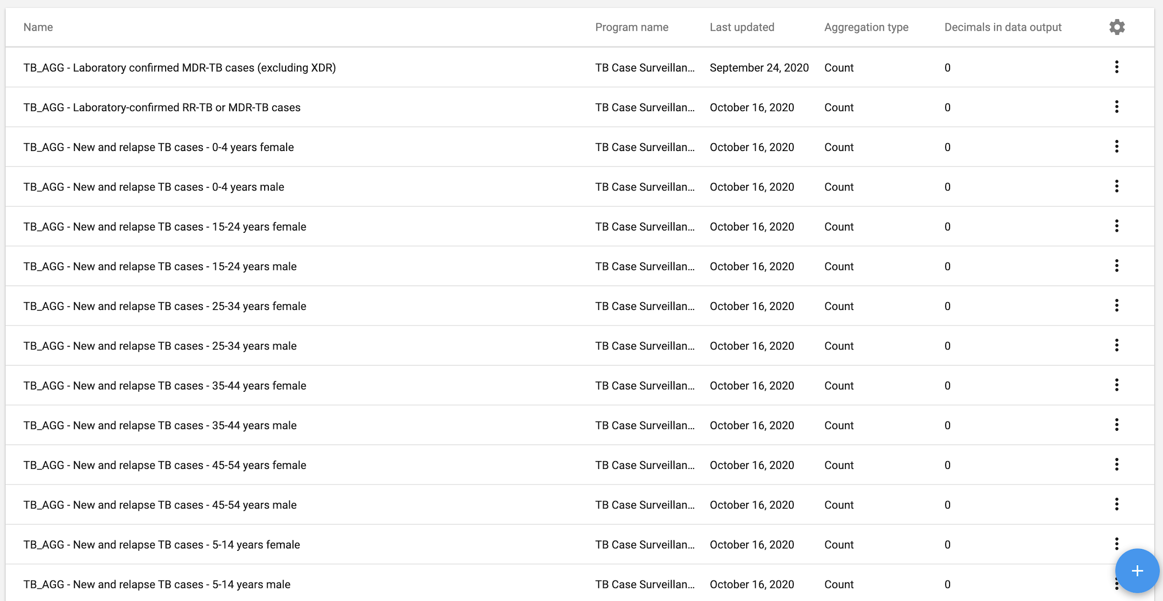

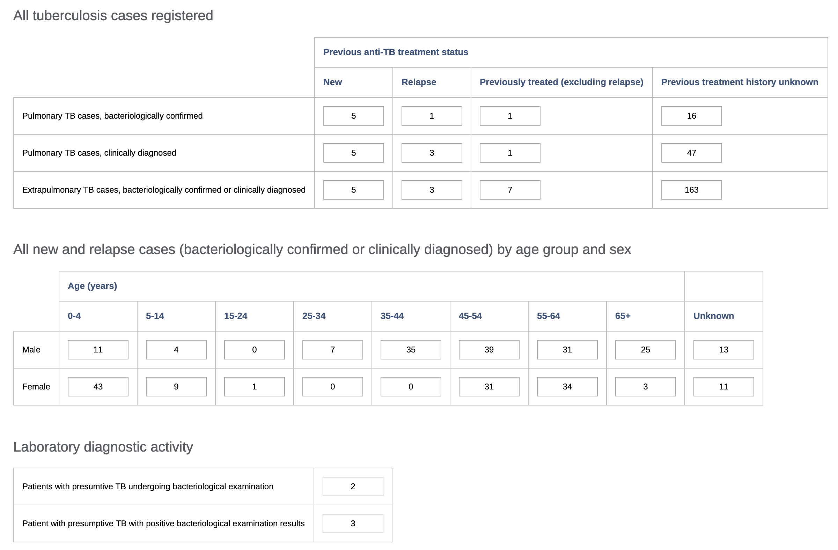

Aggregation of tracker data values
Yury Rogachev, DHIS2 Implementer University of Oslo / DevOtta

Slide 2
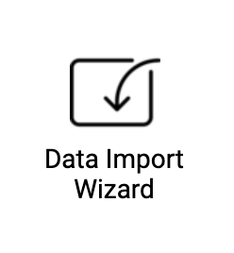
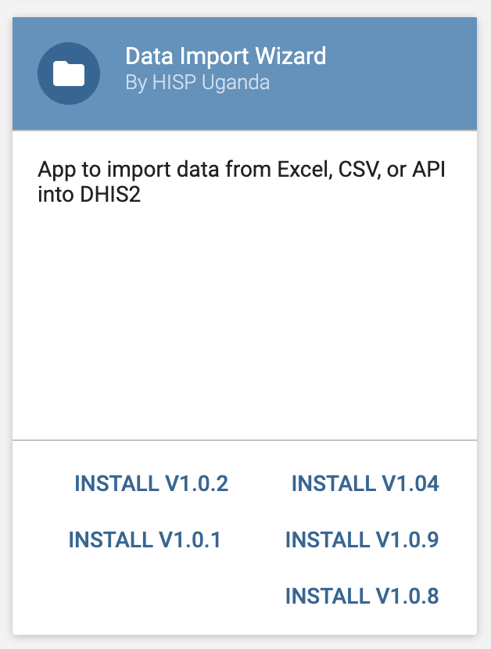
Overview: Data import app
Data Import Wizard App by HISP Uganda
User friendly interface
Support of various import types
Saved mappings
Considerations: manual mapping process,
Best suited for small-scale data sets

Slide 3
Data Import Wizard
Install and start app on the aggregate instance
Select Aggregate and create a New Mapping
Specify relevant Data Set, Import type and periods
Enter login information for the source instance Map Organisation Units (done automatically if Org Units match)
Select relevant program indicators
Map data elements and program indicators
Proceed with import of data

Slide 4
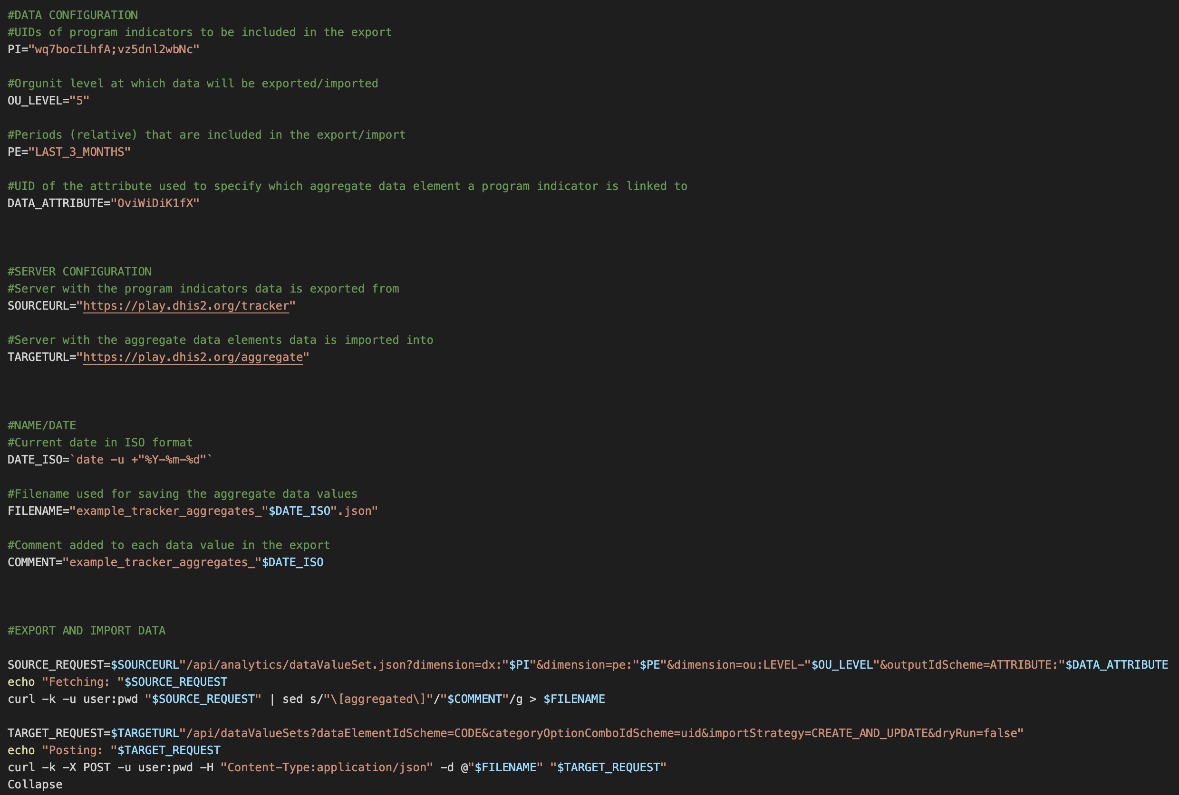
Overview: Tracker to aggregate script
Script Shell executable script
Script requires initial set up Automated periodic export of data to aggregate with eg. task scheduler

Slide 5
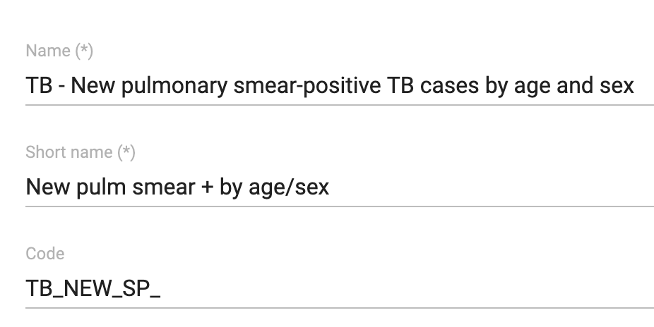
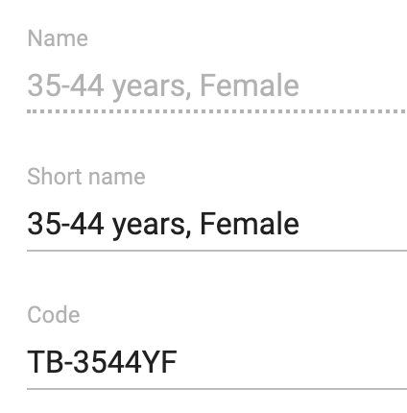
Tracker to aggregate script
Mapping Aggregate module: Data elements and Category option combinations have to be coded Tracker: Program indicators have to be mapped: Custom Attribute: Data element for aggregate data export Category option combination for aggregate data export

Slide 6
Tracker to aggregate script
#!/bin/bash
​#DATA CONFIGURATION
#UIDs of program indicators to be included in the export
PI="wq7bocILhfA;vz5dnl2wbNc"
#Orgunit level at which data will be exported/imported
OU_LEVEL="5"
#Periods (relative) that are included in the export/import
PE="LAST_3_MONTHS"
​
#UID of the attribute used to specify which aggregate data element a program indicator is linked to
DATA_ATTRIBUTE="OviWiDiK1fX"
​
#SERVER CONFIGURATION
#Server with the program indicators data is exported from
SOURCEURL="https://play.dhis2.org/tracker"
​
#Server with the aggregate data elements data is imported into
TARGETURL="https://play.dhis2.org/aggregate"
#NAME/DATE
#Current date in ISO format
DATE_ISO=`date -u +"%Y-%m-%d"`
​
#Filename used for saving the aggregate data values
FILENAME="example_tracker_aggregates_"$DATE_ISO".json"
​
#Comment added to each data value in the export
COMMENT="example_tracker_aggregates_"$DATE_ISO
​
​
​
#EXPORT AND IMPORT DATA
​
SOURCE_REQUEST=$SOURCEURL"/api/analytics/dataValueSet.json?dimension=dx:"$PI"&dimension=pe:"$PE"&dimension=ou:LEVEL-"$OU_LEVEL"&outputIdScheme=ATTRIBUTE:"$DATA_ATTRIBUTE
echo "Fetching: "$SOURCE_REQUEST
curl -k -u user:pwd "$SOURCE_REQUEST" | sed s/"\[aggregated\]"/"$COMMENT"/g > $FILENAME
​
TARGET_REQUEST=$TARGETURL"/api/dataValueSets?dataElementIdScheme=CODE&categoryOptionComboIdScheme=uid&importStrategy=CREATE_AND_UPDATE&dryRun=false"
echo "Posting: "$TARGET_REQUEST
curl -k -X POST -u user:pwd -H "Content-Type:application/json" -d @"$FILENAME" "$TARGET_REQUEST"
Collapse
​

